Slide 1


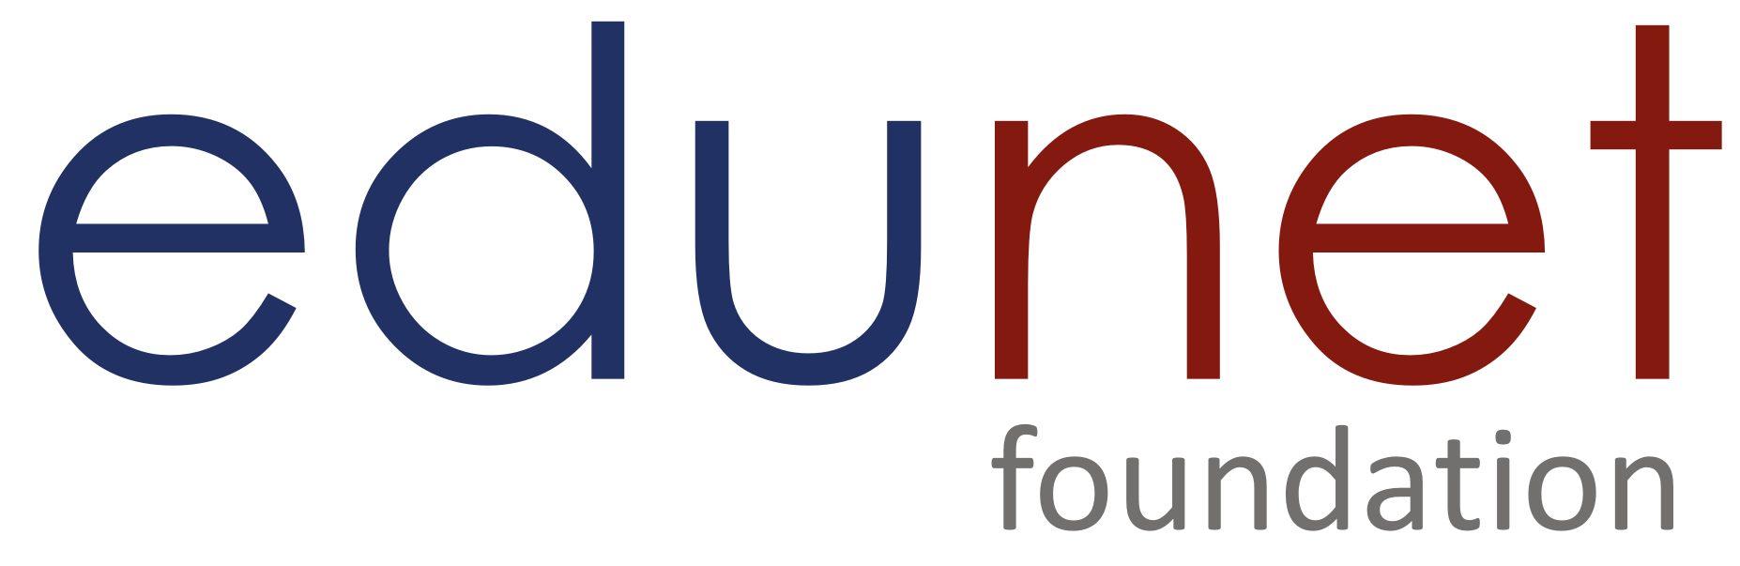

NEXT GEN EMPLOYABILITY PROGRAM
Creating a future-ready workforce
Team Members
College Name
Student Name :S.Balavairavi
Student ID :au814721104010
SRM TRP ENGINEERING COLLEGE

Slide 2

CAPSTONE PROJECT SHOWCASE
Project Title
Notes Sharing Web Application using Django Framework
Abstract | Problem Statement | Project Overview | Proposed Solution | Technology Used | Modelling & Results | Conclusion

Slide 3
Abstract
This project focuses on the development of a note-sharing web application leveraging the Django framework. With the increasing need for collaborative learning and knowledge sharing, this application aims to provide users with a platform to create, share, and collaborate on notes seamlessly. The Django framework, known for its scalability, security, and rapid development capabilities, serves as the foundation for building robust web applications. Through this project, we delve into the architectural design, implementation, and key features of the note-sharing application, including user authentication, note creation, editing, sharing, and version control.
Additionally, we explore the integration of modern web technologies to enhance user experience, such as real-time collaboration and responsive design. By combining Django's powerful features with innovative functionalities, this project contributes to the advancement of collaborative learning environments and knowledge dissemination on the web.
Source :

Slide 4
Problem Statement
In educational institutions, there is a growing need for an efficient and secure platform that facilitates document management between students and teachers. Existing systems often lack user-friendly interfaces, robust security measures, and seamless document upload/download functionalities, leading to inefficiencies and potential privacy risks.
The problem to be addressed is the absence of a comprehensive web application tailored for educational settings, where students and teachers can securely login to upload and download documents relevant to their coursework. The current manual document exchange processes are cumbersome, prone to errors, and do not provide adequate control over document access and management
Source :

Slide 5
Project Overview
In the realm of note-taking and sharing, users encounter several challenges that impede their productivity and collaboration efforts. These challenges include:
Fragmented Tools: Users often resort to using multiple applications or tools for note-taking, organization, and sharing. This fragmentation can lead to inefficiencies, as users must navigate between different platforms, each with its own interface and features.
Security Concerns: Many existing note-sharing platforms may lack robust security measures, leaving user data vulnerable to breaches or unauthorized access. Without proper encryption and authentication mechanisms, users may hesitate to share sensitive information via these platforms.
Source :

Slide 6
Proposed Solution
.
The proposed solution aims to develop a comprehensive web application that caters to the document management needs of educational institutions. The solution will include the following key components and functionalities: User Authentication and Authorization: Implement secure login portals for students and teachers using JWT (JSON Web Tokens) for authentication. Enforce role-based access control to ensure that users can only access functionalities relevant to their roles (e.g., teachers can upload documents, students can download documents). Document Upload and Download: Teachers will have the ability to upload lecture notes, assignments, and supplementary materials through a user-friendly interface. Students can browse and download relevant documents based on their courses or subjects. Implement file upload functionalities with support for various document formats and size restrictions if necessary.
Source :

Slide 7


Technology Used
Front-end
Back-end
Source :

Slide 8
Modelling & Results
Modeling:
Database Modeling:
The application's data model is designed using Django's built-in ORM (Object-Relational Mapping) to define the structure of the database tables.
Search and Organization:
A powerful search functionality allows users to search for notes based on keywords, titles, categories, tags, or other criteria.
Results:
The Notes Sharing Web Application built on the Django framework provides users with a centralized platform for creating, organizing, and sharing notes efficiently.Users can collaborate seamlessly on notes, track changes, and communicate with collaborators in real-time.
Source :

Slide 9
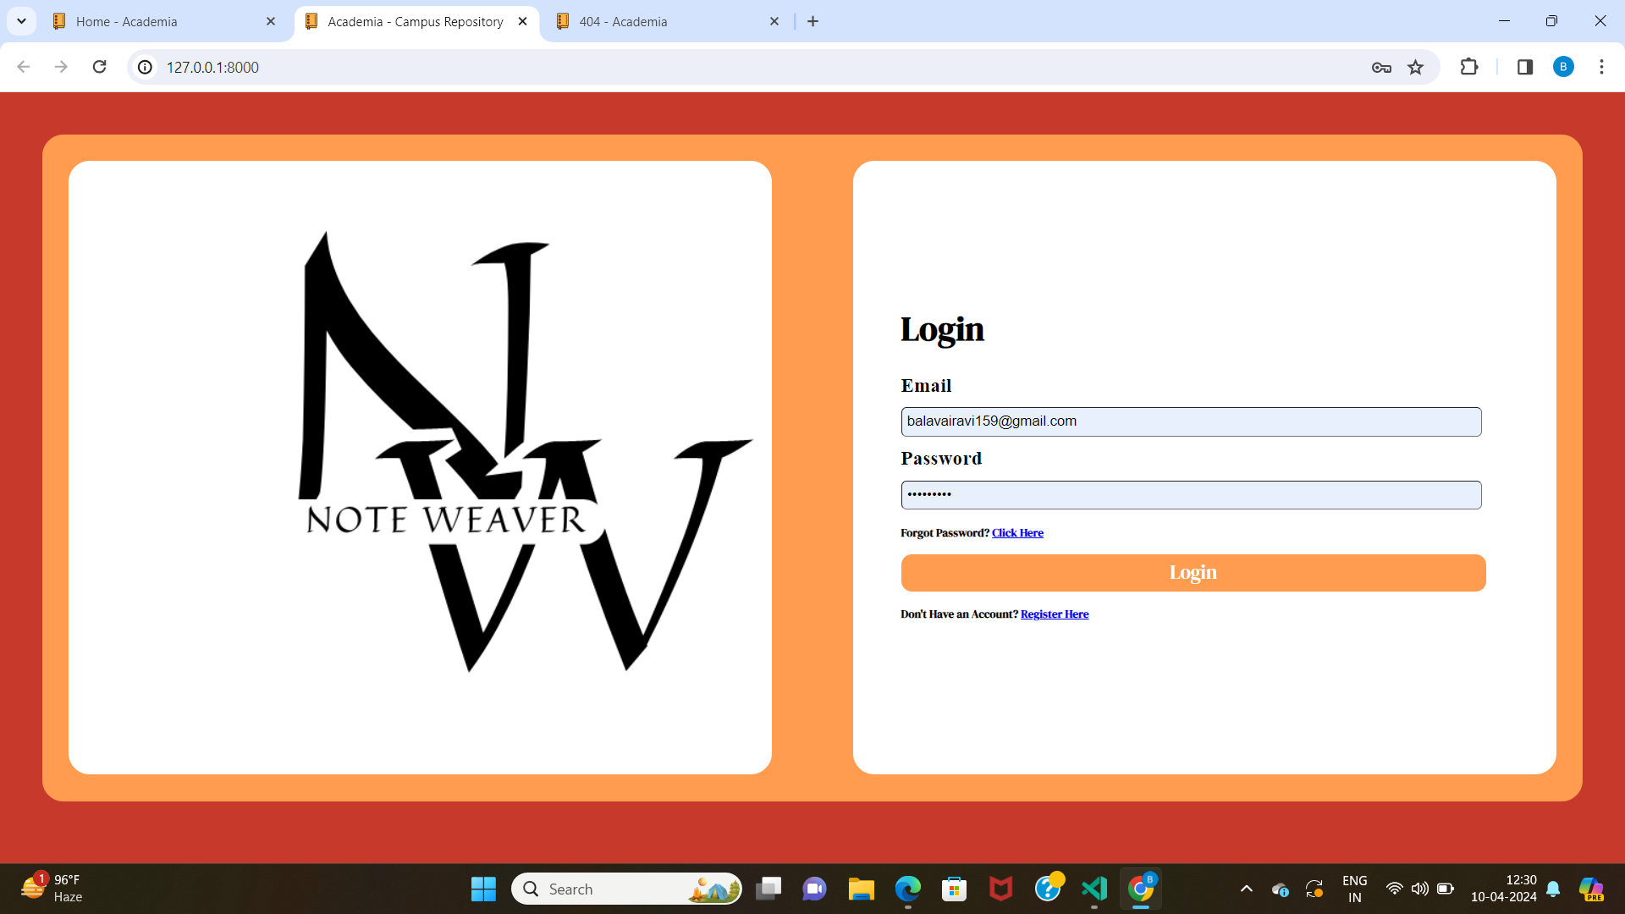
Login:

Slide 10
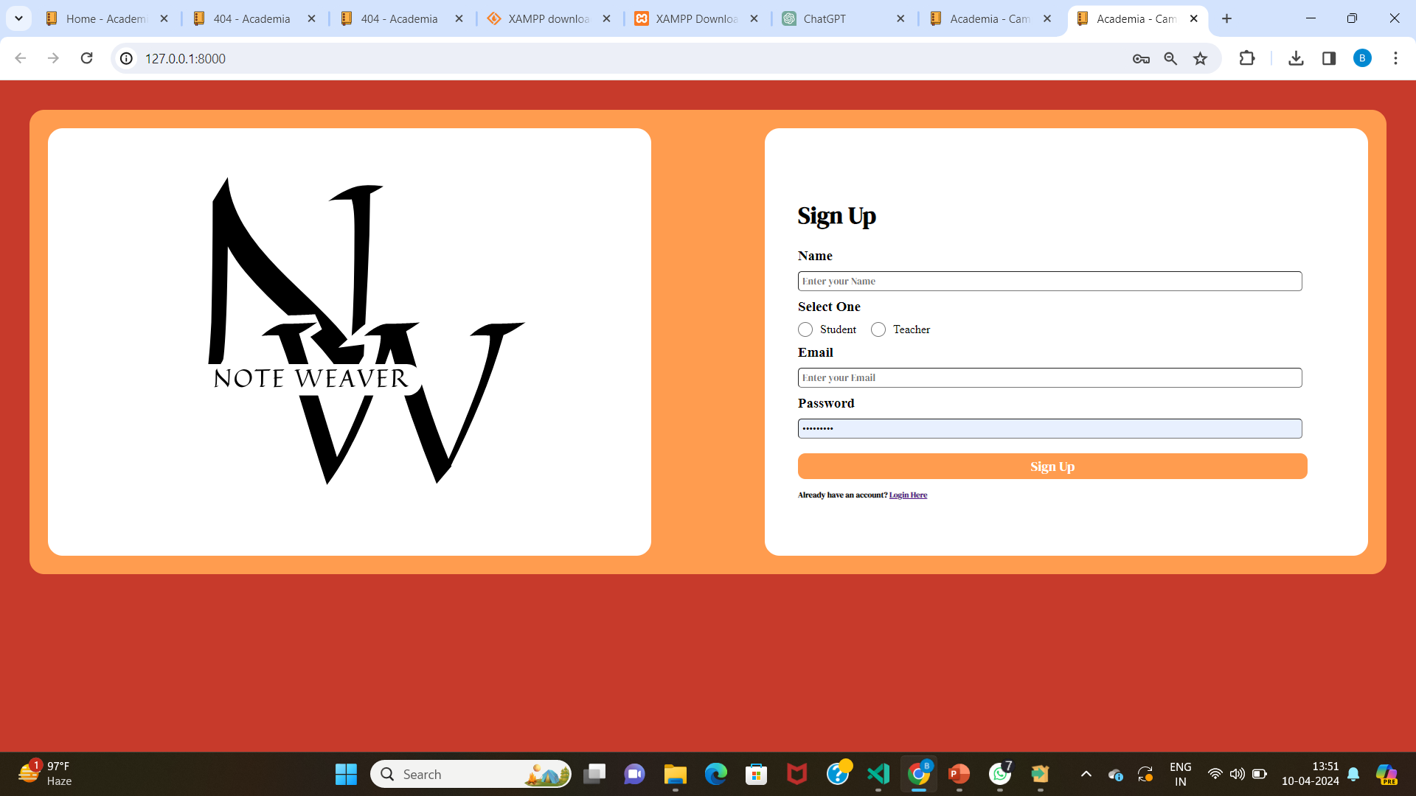
Sign Up:

Slide 11
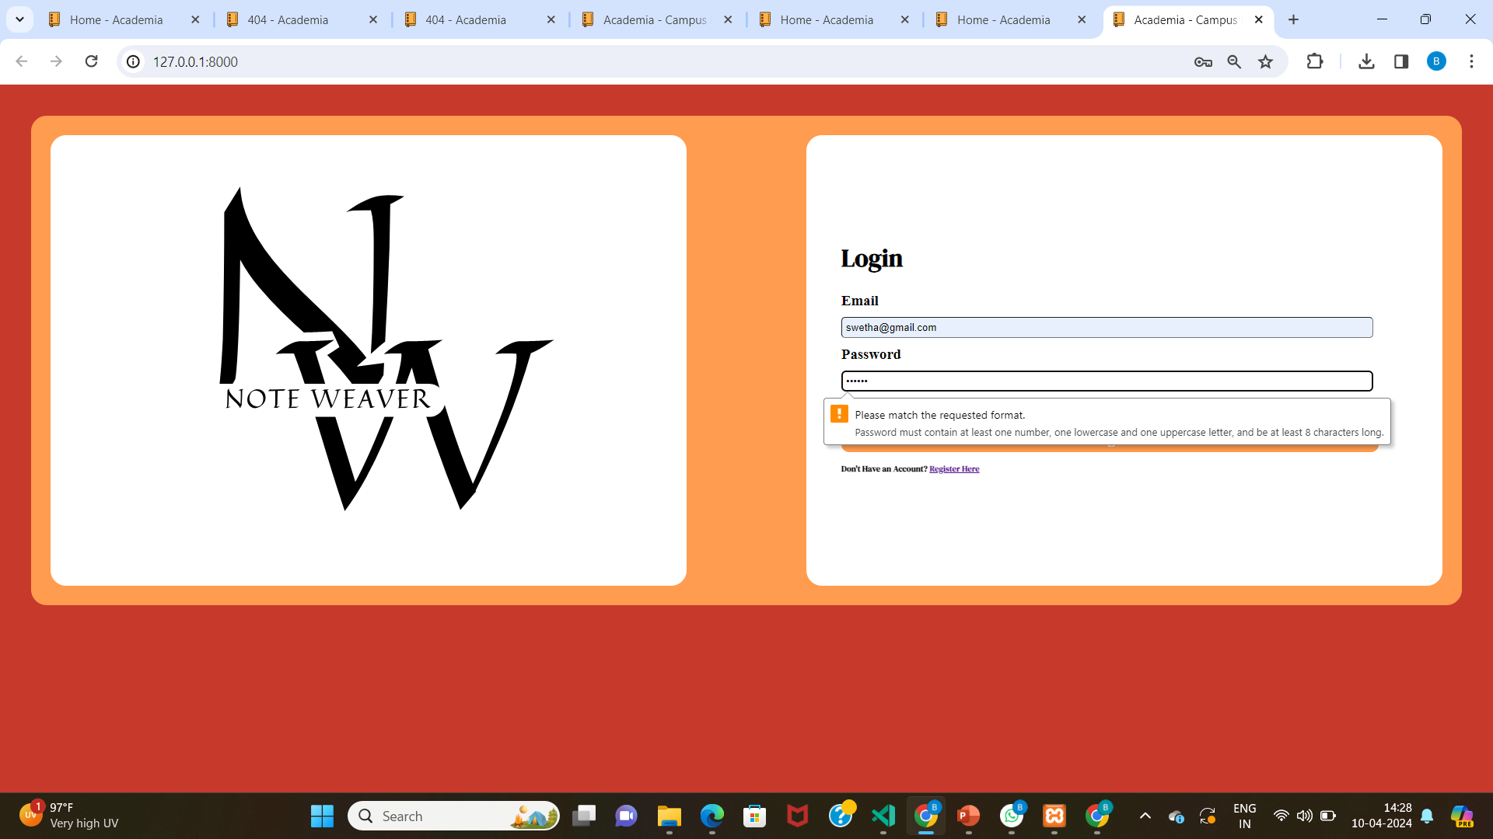
Error Notification:

Slide 12
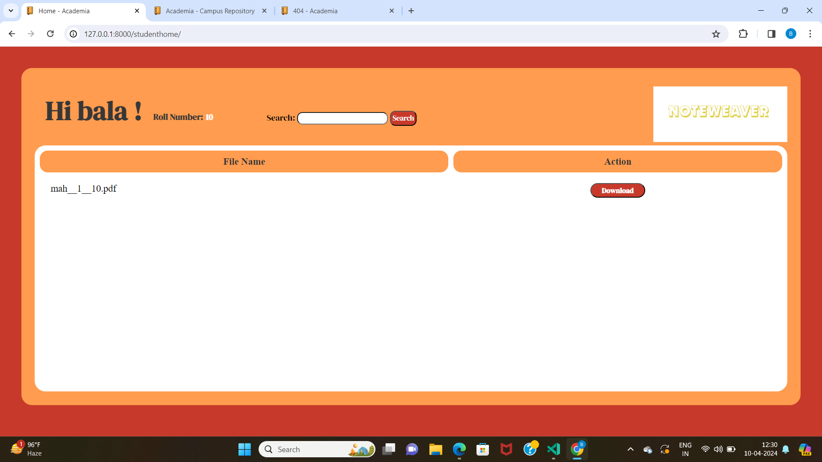
Student login:

Slide 13
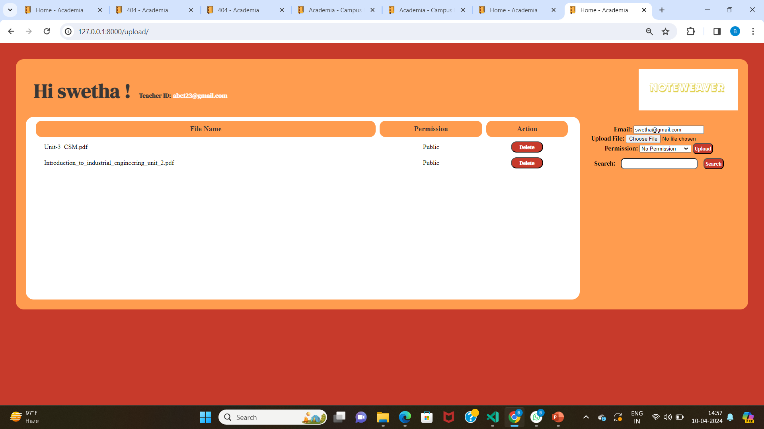
Teacher Login:

Slide 14
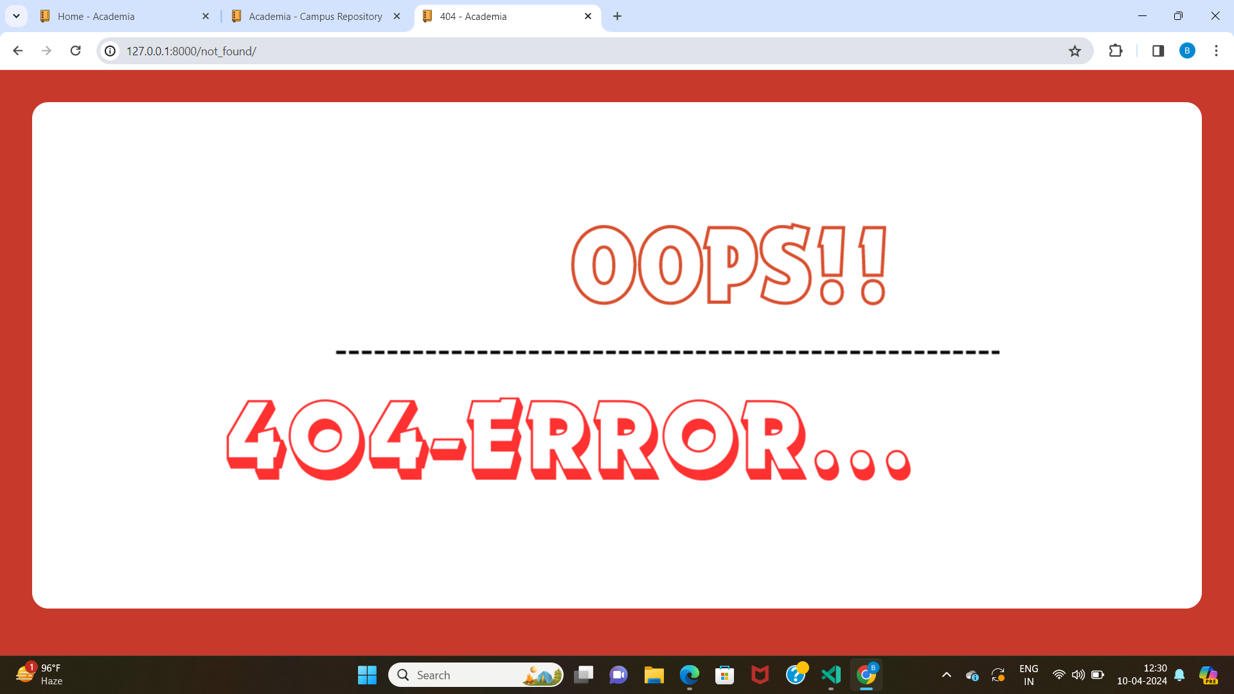
404 Error:

Slide 15
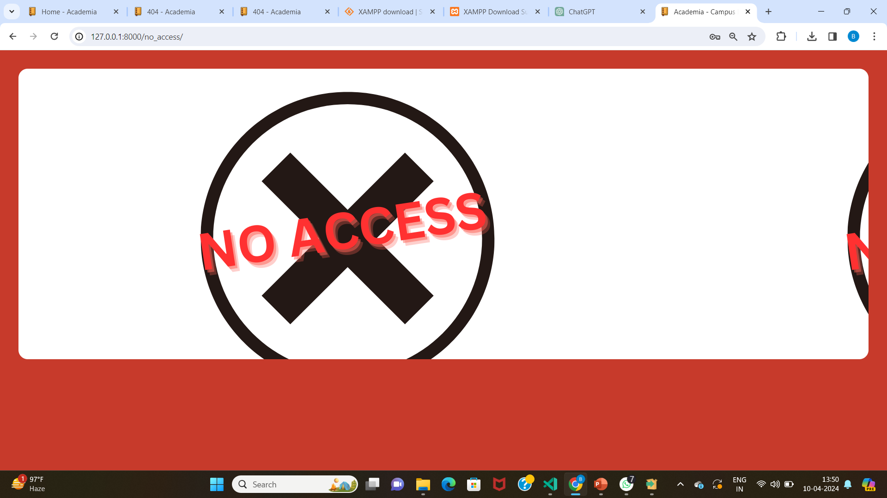
No Access:

Slide 16
Future Enhancements:
Advanced Collaboration Features
Integration with External Tools
Enhanced Security Measures
Mobile Application Support
Offline Access and Synchronization
Customizable Templates and Workflows
Analytics and Insights
Accessibility Features
Community and User Feedback Integration

Slide 17
Conclusion
The Notes Sharing Web Application developed on the Django framework presents a comprehensive solution to the challenges encountered in note-taking, organization, and sharing. By providing a centralized platform with robust security measures, advanced collaboration features, efficient organization tools, and a user-friendly interface, the application aims to streamline workflows, enhance productivity, and facilitate seamless knowledge sharing among users.
Overall, the Notes Sharing Web Application serves as a valuable tool for individuals, teams, and organizations seeking to streamline their note-taking processes, collaborate effectively, and harness the power of shared knowledge. Through continuous refinement and innovation, the application will continue to evolve and remain a vital asset for users in their quest for productivity and collaboration excellence.
Source :

Slide 18
Thank You!
Notes:
Thank You !!

